Slide 1

Hospital management system

Slide 2
Description of project
Hospital are the essential part of our lives. Providing best medical facilities to people suffering from various ailment, which may be due to change in climate conditions, increased work-load etc.
It necessary for the hospitals to keep track of its day-to-day activities & records of its patient , doctors ,nurse ward boy and other staff personal that keep the hospital running smoothly & successfully.

Slide 3
Objective of the project
The project “Hospital Management System” is aimed to develop to maintain the day- to-day state of data of patients, list of doctors , bill generation , and etc. it is designed to achieve the objective.

Slide 4
Certificate
It is certified that the work contained in this project entitled “Hospital management system” by Rishabh Sharma and Shailandra kumar for forward of Bachelor of Technology from Sharda University has been carried out my supervision.
Sandip Saxena Nitin Rakesh
Computer science(SET) HOD,CSE(SET)
Sharda University(Noida) Sharda University(Noida)

Slide 5
abstract
My project hospital management system includes registration of patients, storing their details into the system and also my software has the facilities to give a unique id for every patients and stores the details of every doctors as well for the betterment in hospital management
It is accessible either administrator or receptionist . only they can add , modify & delete data in data base. The interface is very user friendly .

Slide 6
Acknowledgement
Whenever the project is completely successful . Here by take the opportunity to thanks those entire people who help me in many different ways.
I am grateful to my thesis guide Professor Sandeep Saxena, Sharda University.

Slide 7
introduction
The project of Hospital Management System include the registration of patient and doctor .
The software has the facilities to give a unique id to the every patient and every doctor and store the detail of the patients and the doctors in the system.
The user can search the availability of the doctor and the patient by using the patient id.

Slide 8
objectives
The project “Hospital Management System” is aimed to develop to maintain the day- to-day state of admission/discharge of patients, list of doctors ,report generation , and etc. it is designed to achieve the objective.
The software is for the automation of hospital management .
The software includes:
Maintain patient details.
Billing and report generation
Maintain record of doctor
Detail of room

Slide 9
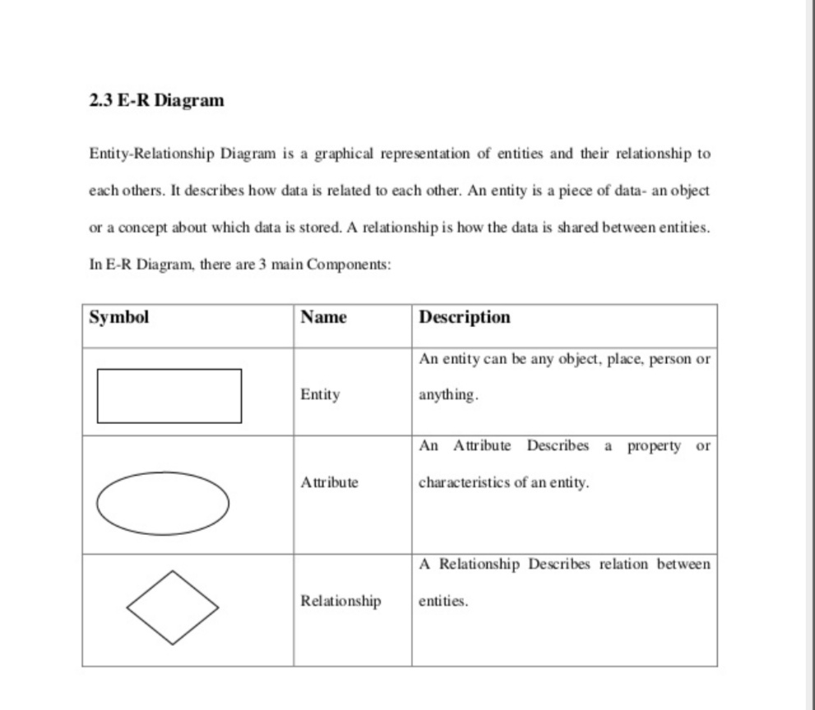
Er-diagram

Slide 10
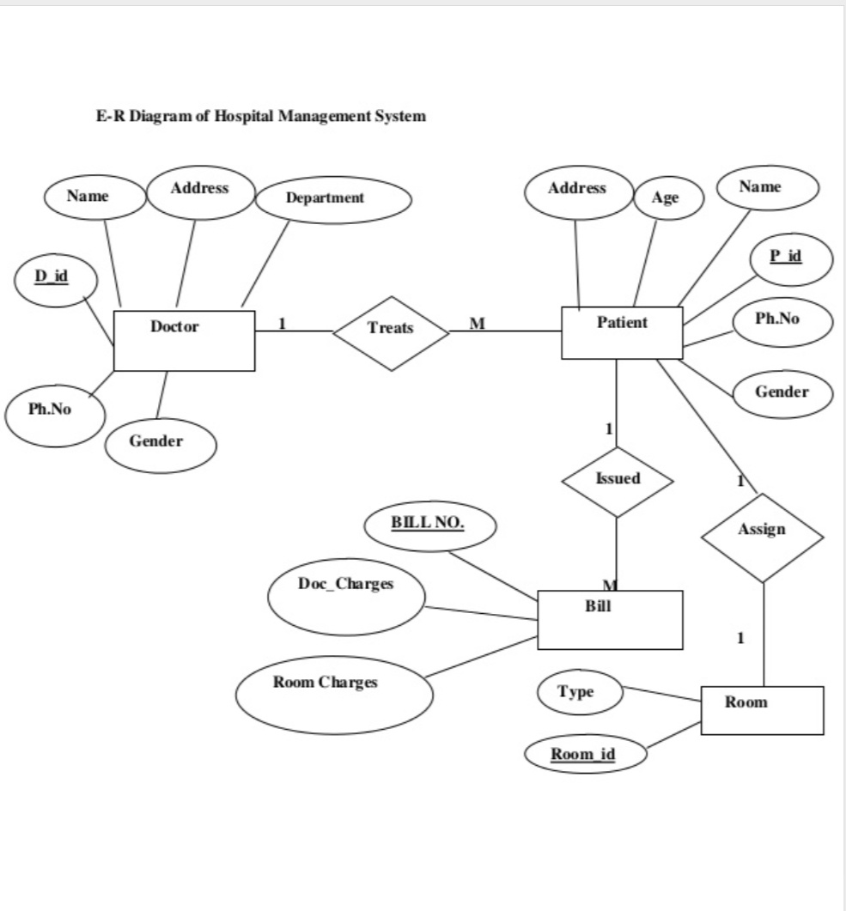
Er -diagram

Slide 11
CREATE Doctor table
Doctor details
name | type | size
D _ id | integer | _
D _ name | varchar | 20
D _ address | varchar | 40
D _ gender | varchar | 10

Slide 12
CONTINUED
D_id | D_name | D_address | D_gender | D_phone
101 | Uttam | Noida | M | 7739345669
102 | Shuhail | Delhi | M | 7890456778
103 | Aman | Patna | M | 9856784534
104 | Ashish | Delhi | M | 9056782345
105 | Manish | punjab | M | 8846309234

Slide 13
create Room table
Name | Type | Size
Room _ no | int
Room _ type | varchar | 15

Slide 14
Room table
Room_no | Room_type
101 | AC
102 | Non-AC
103 | AC
104 | Non-AC
105 | AC

Slide 15
Patient table
Name | Type | Size
Name | varchar | 20
Id | int
Age | int
Gender | varchar | 10
Address | varchar | 20
date | varchar | 10

Slide 16
CONTINUED
Name | Id | Address | Age | Gender | date
Sunil | 101 | Noida | 19 | M | 20/11/18
Uman | 102 | Delhi | 20 | M | 18/11/18
Manish | 103 | Gr . Noida | 18 | M | 16/11/18

Slide 17
Billing table
Name | Type | Size
Bill_no | Int
Patient_id | Int
Name | Varchar | 20
Age | Int
Room_no | Int
Date | varchar | 10

Slide 18
CONTINUED
Bill _No | Patient _Id | Name | Gender | Room _No | Date
101 | 101 | Shuhail | M | 102 | 20/11/18
102 | 103 | Uttam | M | 101 | 17/11/18
103 | 102 | Sanjay | M | 103 | 19/11/18

Slide 19
FIRST NF:
First Normal Form (1NF) A table is said to be in First Normal Form (1NF) if and only if each attribute of the relation is atomic. That is, Each row in a table should be identified by primary key (a unique column value or group of unique column values) No rows of data should have repeating group of column values.
SECOND NF:
Second normal form (2NF) is a normal form used in database normalization. ... Specifically: a relation is in2NF if it is in 1NF and no non-prime attribute is dependent on any proper subset of any candidate key of the relation.
THIRD NF:
Third Normal Form (3NF) A relation will be in 3NF if it is in 2NF and not contain any transitive partial dependency. 3NF is used to reduce the data duplication. It is also used to achieve the data integrity. If there is no transitive dependency for non-prime attributes, then the relation must be in third normal form.

Slide 20
All the tabels are in 3NF

Slide 21
Relation between tables
Here Doctor _ id , Bill _ no , Patient _ id and Room _ id is primary key
Relation between doctor and patient is ‘ treats’ with one to many
Relation between patient and bill is ‘issued ‘ with one to many
Relation between patient and room is ‘Assign ‘ with one to one

Slide 22
SQL
CREATE TABLE `appointments` (
`ID` INTEGER PRIMARY KEY AUTOINCREMENT,
`NAME` TEXT,
`AGE` TEXT,
`GENDER` TEXT,
`LOCATION` TEXT,
`PHONE` INTEGER,
`SCHEDULED TIME` TEXT
);
CREATE TABLE `doctor` (
`d_id` INTEGER PRIMARY KEY AUTOINCREMENT UNIQUE,
`d_name` TEXT,
`d_department` TEXT,
`d_gender` TEXT,
`d_phone` TEXT,
`d_address` TEXT
);

Slide 23
CREATE TABLE `billing` (
`bill_no` TEXT,
`room_charge` TEXT,
`document_charge` TEXT,
`total_amount` TEXT
);
"INSERT INTO 'doctor' (d_name , d_department , d_gender , d_phone , d_address) VALUES(?,?,?,?,?)“
"SELECT * FROM appointments WHERE name LIKE ?“
"UPDATE appointments SET NAME=?, AGE=?, GENDER=?, LOCATION=?, PHONE=?, SCHEDULED_TIME=? WHERE NAME LIKE ?“
"DELETE FROM appointments WHERE name LIKE ?"

Slide 24
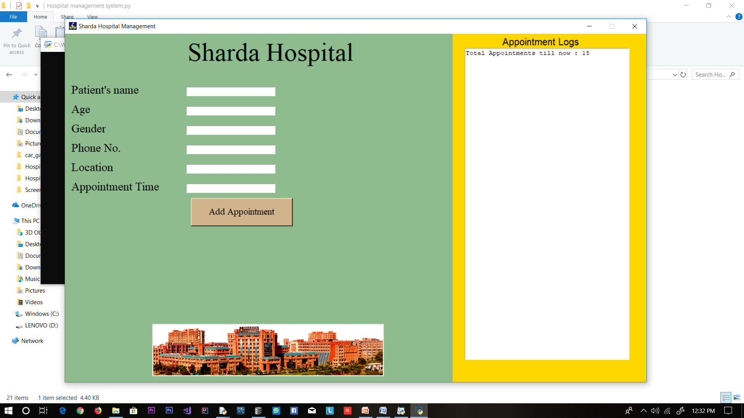
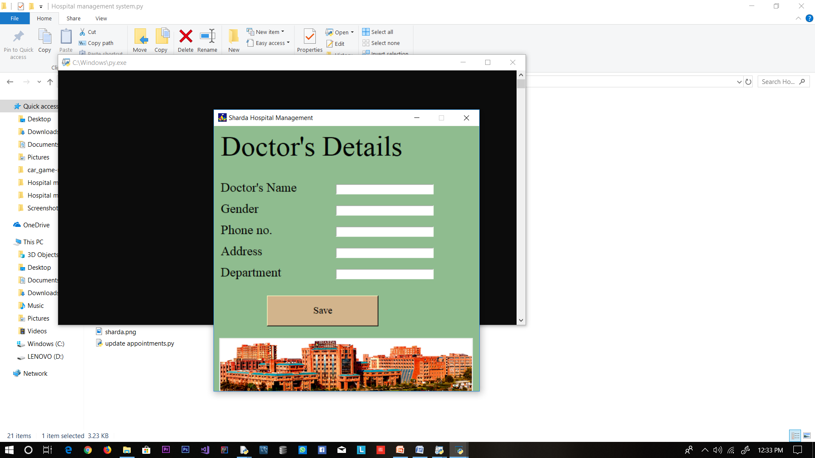
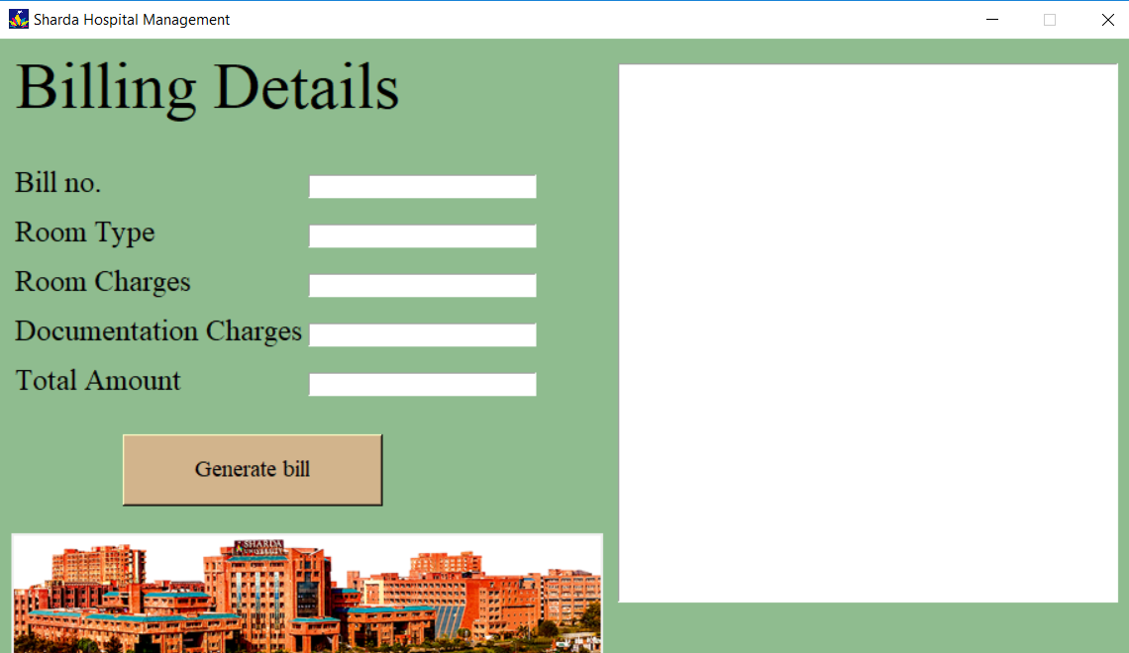
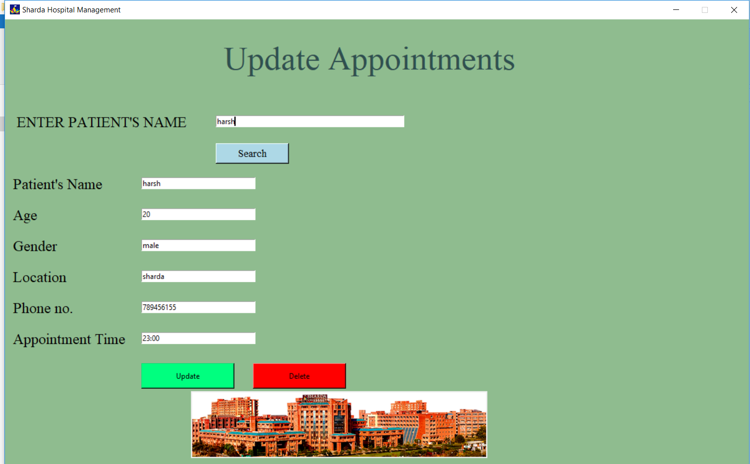

Slide 25
Thank you
Project submitted by:-
Rishabh Sharma
Shailender Kumar

